Slide 1
Dominos - Predictive Purchase Order System
By
Rajalakshmi mathaiyan

Slide 2
Problem Statement
Dominos wants to optimize the process of ordering ingredients by predicting future sales and creating a purchase order.
By accurately forecasting sales, Dominos can ensure that it has the right amount of ingredients in stock, minimizing waste and preventing stockouts.
This project aims to leverage historical sales data and ingredient information to develop a predictive model and generate an efficient purchase order system.

Slide 3
Dataset
Pizza Sales Dataset
Sales Data: Historical sales records (Date, Pizza Type, Quantity Sold, Price, Category, Ingredients)
Pizza Ingredients Dataset
Ingredient Data: Ingredient requirements for each pizza type (Pizza Type, Ingredient, Quantity Needed)

Slide 4
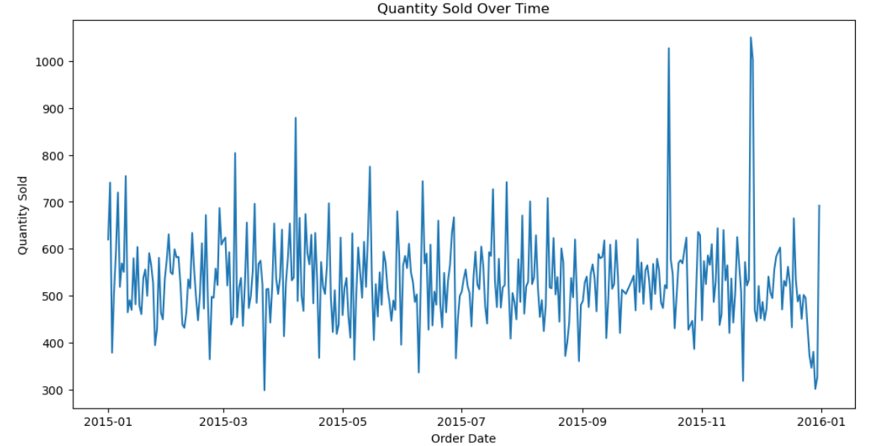
Exploratory data visualization

Slide 5
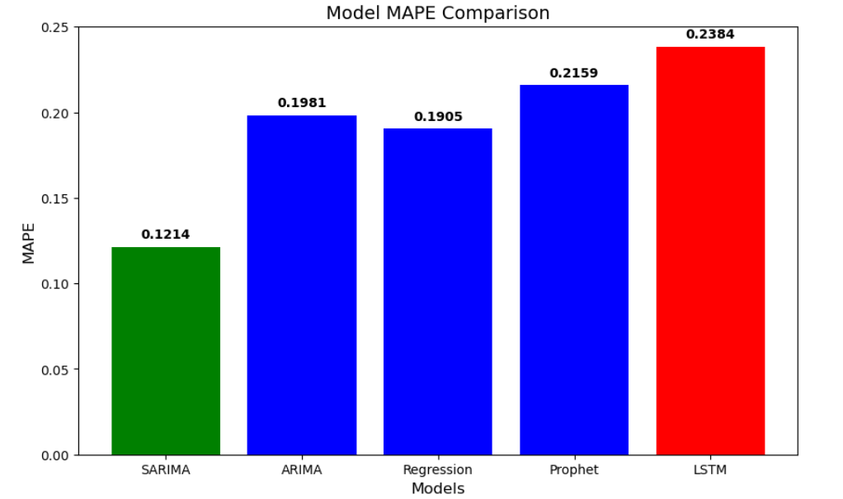
Model building and evaluation

Slide 6
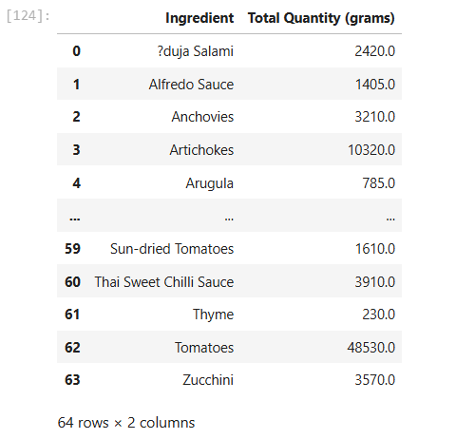
Purchase Order generation

